Slide 1
Sword fern dieoff disease transmission experiments
Marianne Elliott, Plant Pathologist WSU Puyallup Research and Extension Center

Slide 2
Possible biotic causes of dieoff
Soilborne pathogen
Fungus, oomycete, nematode, bacteria, other non-culturable organism
Vascular wilt pathogen with vector
Bacteria, virus, phytoplasma, other non-culturable organism
Vector can be an insect or other soil organism, or possibly a foliar feeder
Other questions:
Does age/size of the fern rhizome matter?
Is this organism already present as an endophyte and some stress is causing it to be pathogenic?

Slide 3
Previous surveys
Olaf Ribiero
Rhizoctonia isolated from dead, rotting stems
Phoma/Glomerella sp. isolated from frond stems (probably opportunistic)
WSU – M. Elliott and J. Glass
No Phytophthora in soil or on plants
No difference in fungal pathogens between healthy and symptomatic plants
No obvious pathogen was isolated that could account for differences between healthy and symptomatic ferns

Slide 4
Soil transmission experiments
Planting into “clean” soil and contaminated soil from dieoff sites
1: J. Oleary – Sandy Hook site, varying fern sources
2: M. Elliott and D. Perrasso – varying soil inoculum, fern seedlings from 1 source
Can talk about this more later if there is time

Slide 5
Sap transmission experiments
Paul Shannon’s bottle experiment – Sept 2018
C
H
C
H
H
H
Crinkly frond & healthy frond, day zero
Crinkly frond & healthy frond, week 3
Healthy frond & healthy frond, week 3

Slide 6
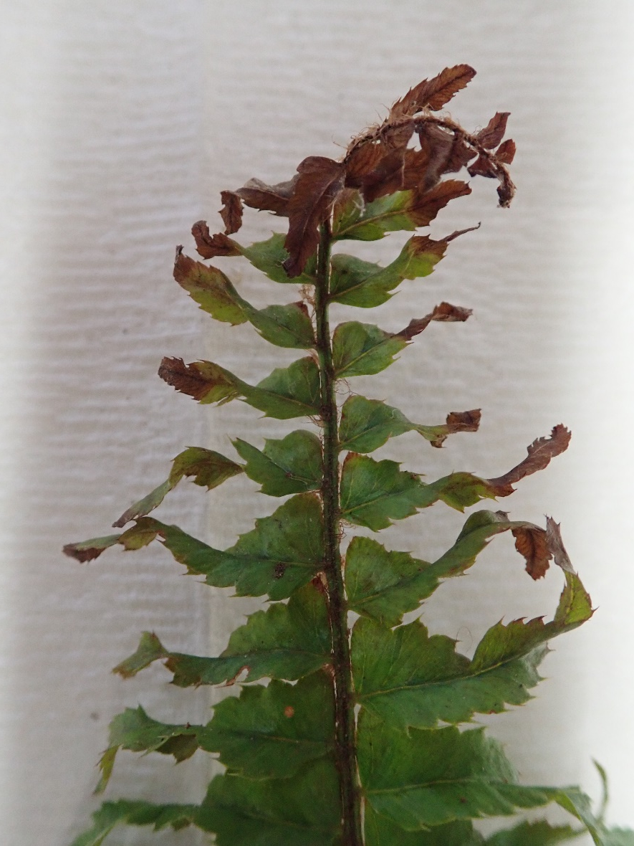
Symptoms
Healthy frond
Frond with twisting, necrotic pinnae
Photo: Paul Shannon

Slide 7
Planned sap transmission experiment
Late August-September 2019
1 carefully selected frond from each of 10 symptomatic plants in dieoff site at SP. Fronds will have “crinkly” symptom. Plants will be mapped and photographed for future reference.
In tubes containing sterile DI water, pair with frond from healthy sword fern at WSUP. In addition, 5 pairs of healthy sword fern fronds will be used as controls.
Sterile technique will be followed to avoid cross contamination. Sterile water, containers, tools, etc.
Place in greenhouse and observe symptoms over 3 week period. Use rating scale.
Repeat.

Slide 8
Rating scale
0 = healthy
1 = beginning stage of infection, < 25% "crinkly" pinnae curved with "crinkly" edges
2 = all pinnae curved with "crinkly" edges
3 = 25-50% of pinnae necrotic
4 = >50% of pinnae necrotic, advanced infection or dead

Slide 9
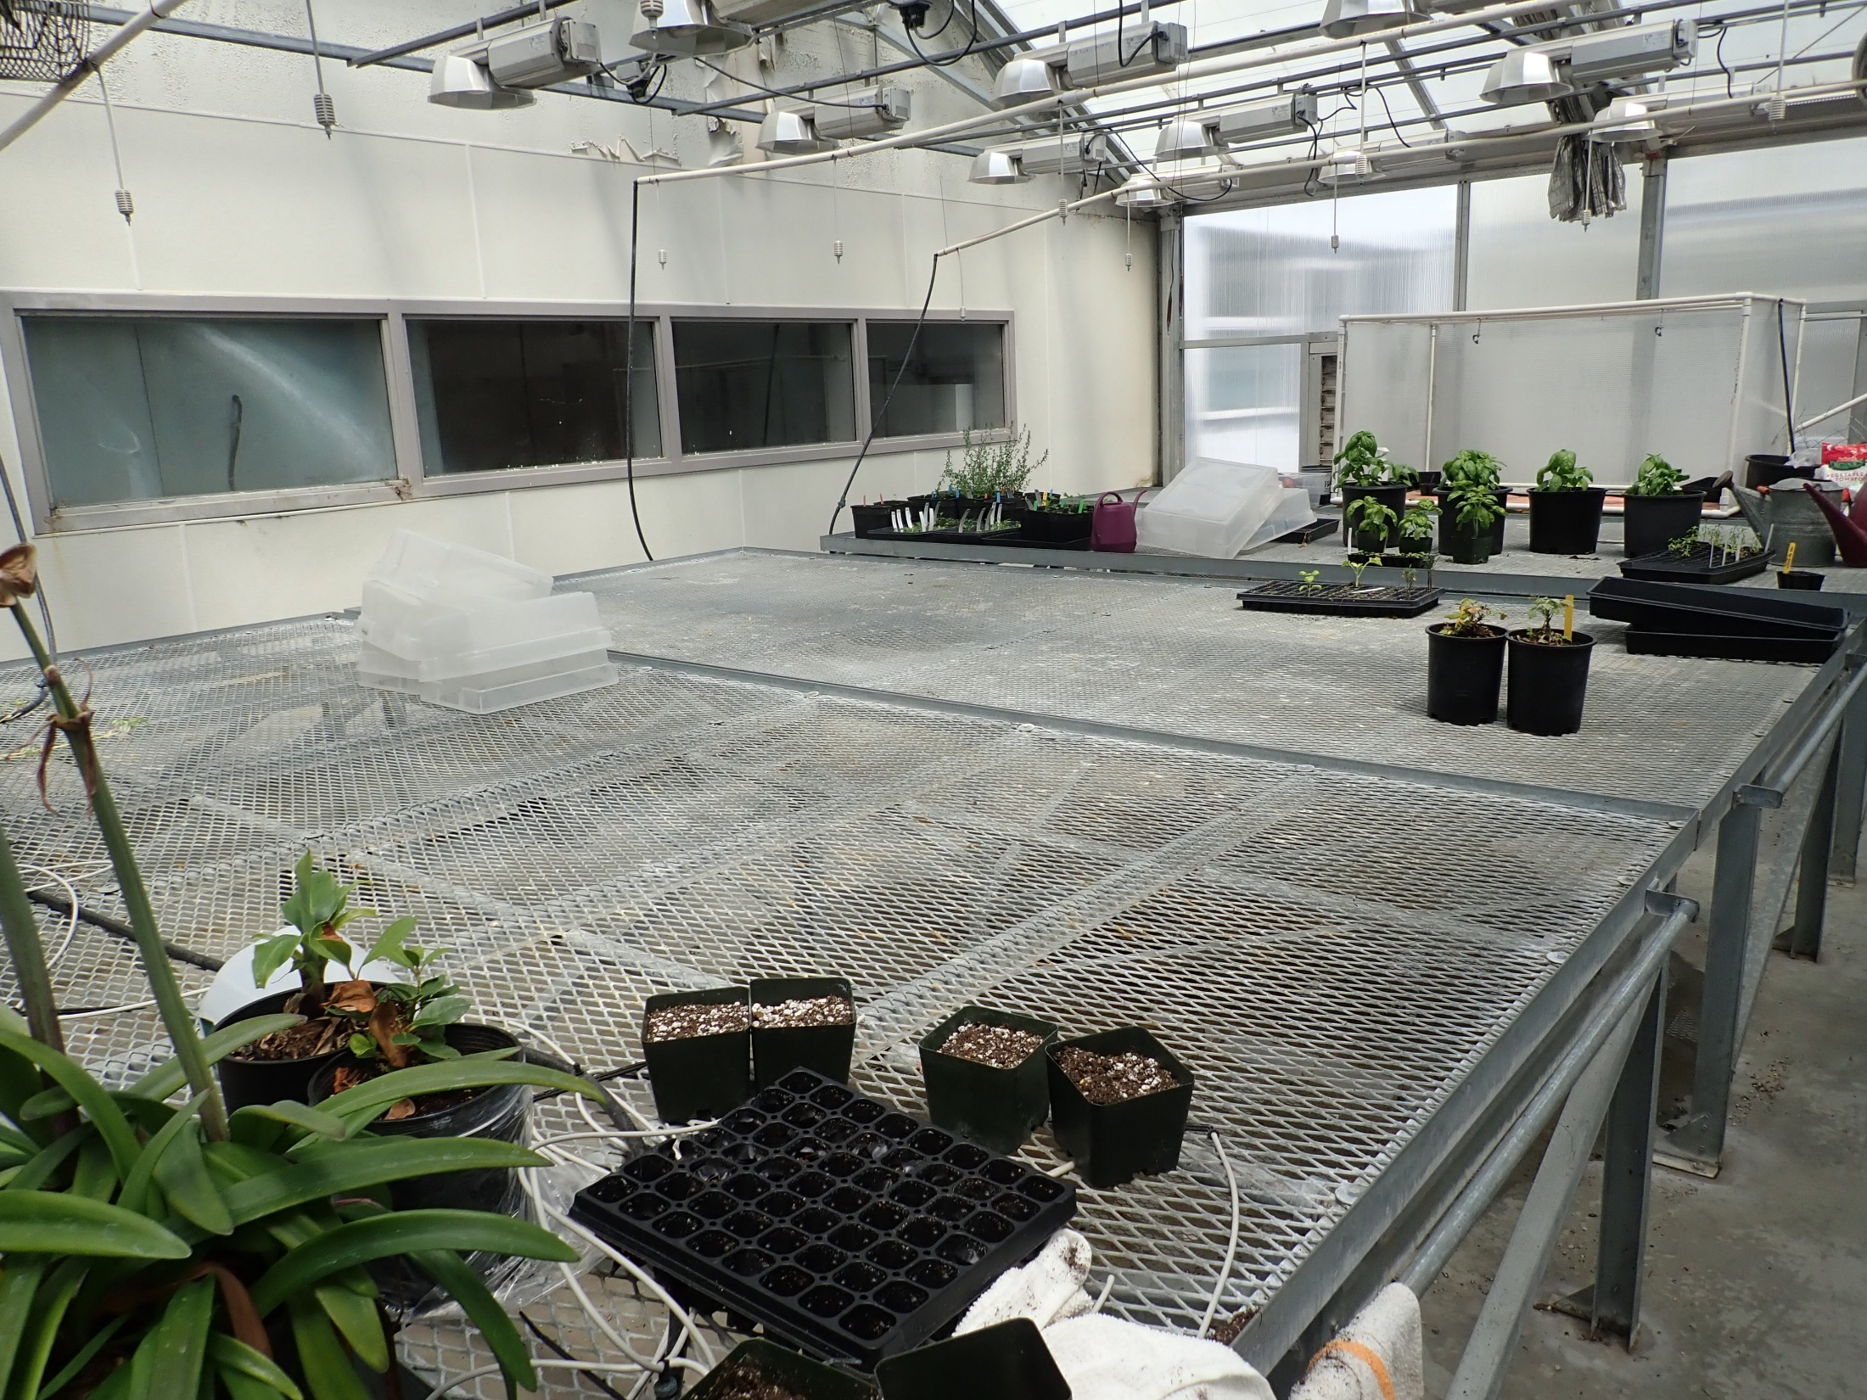
One of the greenhouse spaces at WSUP

Slide 10
If we get results
Test symptomatic fronds from other sites
Characterize the “disease agent” organism in water
Identify the organism using molecular techniques
Confirm Koch’s Postulates by infecting and re-isolating the organism from ferns

Slide 11
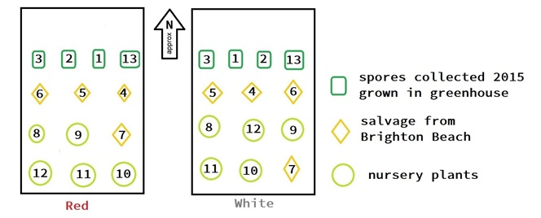
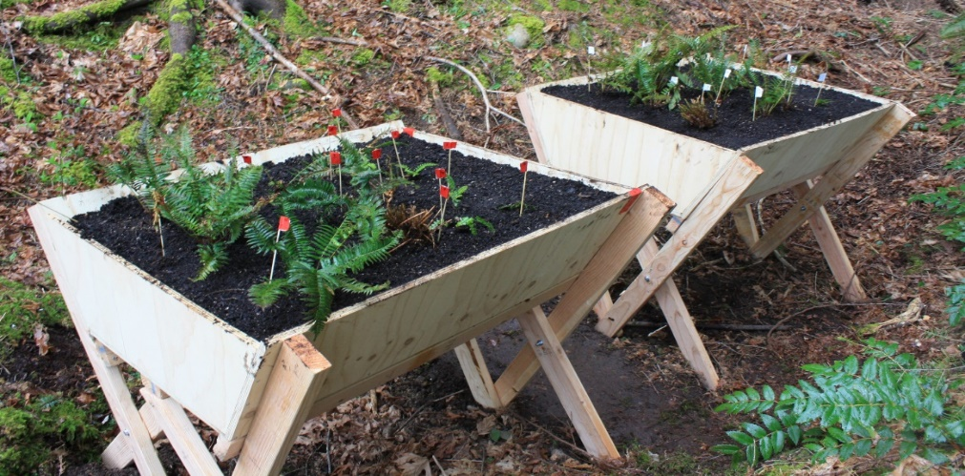
Soil transmission results – Experiment 1
Contaminated Sandy Hook soil
Clean soil

Slide 12
Soil transmission results – Experiment 2

Slide 13
Conclusions
We were not able to isolate a soilborne pathogen
There was no detectable difference in health between ferns growing in clean soil and in soil amended with dieoff site soil
Interesting trends:
Larger ferns (salvaged) had fewer fronds in soil from Sandy Hook dieoff site.

